Slide 1
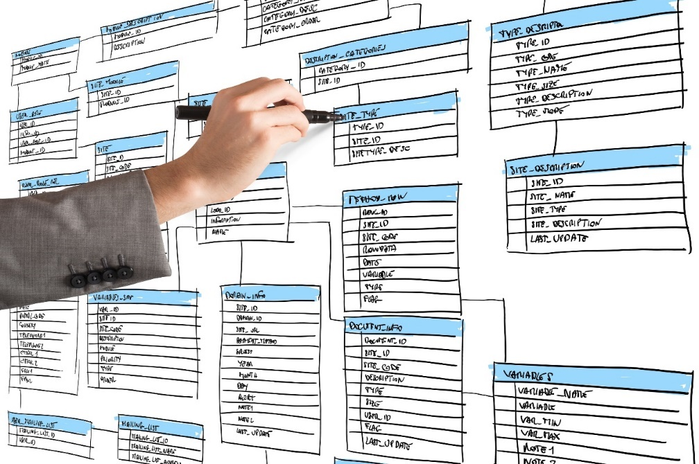
Templates and Tools
Stuff
More stuff

Slide 2
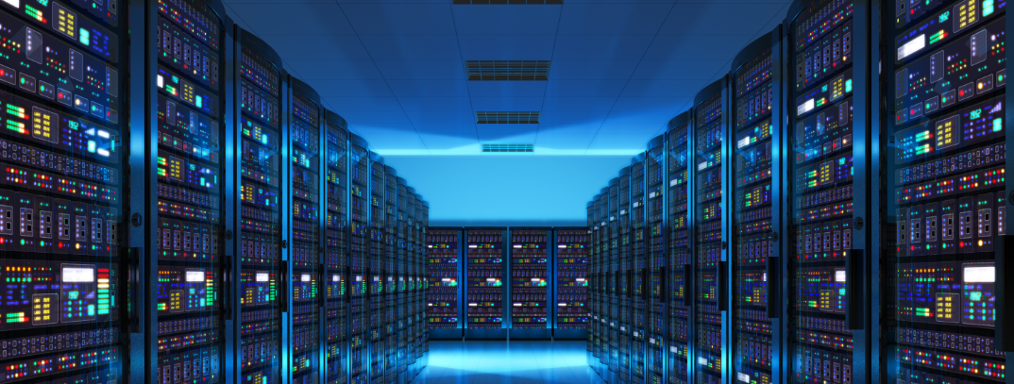
See Also
https://en.wikipedia.org/wiki/Class_diagram
https://tallyfy.com/uml-diagram/
Notes:
Here is some additional reading for you on the web.

Slide 3
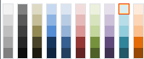
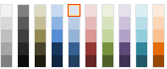
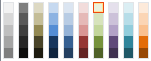
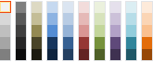
Code Colors
C++
class Clock {
int hours,minutes,seconds;
public:
Clock(int h, int m, int s) :
hours(h),minutes(m),seconds(s) {
}
virtual int getHours() {
return hours;
}
};
Clock c(23,59,59);
int h = c.getHours();
Java
public class Clock {
private int hours;
private int minutes;
private int seconds;
public Clock(int h, int m, int s) {
this.hours = h;
this.minutes = m;
this.seconds = s;
}
public int getHours() {
return this.hours;
}
}
Clock c = new Clock(23,59,59);
int h = c.getHours();
blah
Blah
blah
JavaScript
class Clock:
def __init__(self,h,m,s):
self._hours = h
self._minutes = m
self._seconds = s
def get_hours(self):
return self.hours
c = Clock(23,59,59)
h = c.get_hours()
Python
Z80

Slide 4
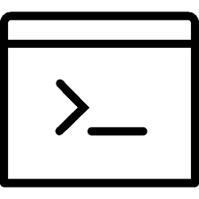

Console Output
Command Prompt - X
C:\
This is some output
Meow!
Meow!
Woof!

Slide 5



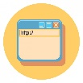
Things
One
Two
Three
Note
https://en.wikipedia.org/wiki/GNU_Classpath
Some terms
keywords
https://en.wikipedia.org/wiki/GNU_Classpath

Slide 6
Diagrams
List
add(e) : boolean
add(index,object) : void
remove(index) : Object
clear() : void
contains(object) : boolean
get(index) : Object
set(index, object) : Object
size() : int
isEmpty() : boolean

Slide 7
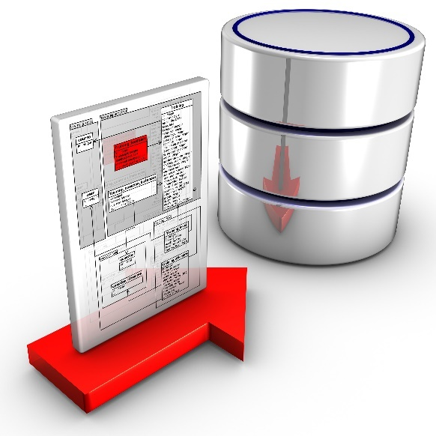
Tinkering
Sketch out the CUSTOMER table. You should track a customer’s address …
Notes:
Here are a couple of things to think about and/or try. This is totally optional … nothing for you to send to me.
Think about a table for customer information. How would you model a list of purchases over time? How would you model a list of favorite authors? (Hint: join tables)
How would you model a temperature network of multiple houses each with multiple sensors each? Only worry about the CURRENT VALUE for the sensor. But give some thought to how you would store historic data for each sensor.

